Slide 1
Wanderings

Slide 2
Wanderings Numbers 11- Deuteronomy 34

Slide 3
Complaining and Grumbling

Slide 4
Important to remember all that God has done for you and be thankful
Time for prayer and giving thanks

Slide 5
Even Miriam and Aaron complained about me.
Grumbling and complaining against God’s appointed leaders bring consequences… will cost you

Slide 6
12 spies sent to survey and report on the Promised Land. Same report but different conclusions.

Slide 7
Moses interceded for the people.
May we continue to intercede and plead before God for our family and friends.

Slide 8
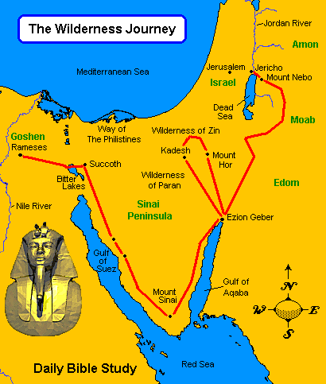
40 years of wandering in the wilderness.

Slide 9
Moses disobeyed God and was not allowed to lead the people into Canaan.
Joshua anointed as new leader.

Slide 10
Deuteronomy 30:15-20
¹⁵ See, I set before you today life and prosperity, death and destruction. ¹⁶ For I command you today to love the Lord your God, to walk in obedience to him, and to keep his commands, decrees and laws; then you will live and increase, and the Lord your God will bless you in the land you are entering to possess.
¹⁷ But if your heart turns away and you are not obedient, and if you are drawn away to bow down to other gods and worship them, ¹⁸ I declare to you this day that you will certainly be destroyed. You will not live long in the land you are crossing the Jordan to enter and possess.

Slide 11
¹⁹ This day I call the heavens and the earth as witnesses against you that I have set before you life and death, blessings and curses. Now choose life, so that you and your children may live ²⁰ and that you may love the Lord your God, listen to his voice, and hold fast to him. For the Lord is your life, and he will give you many years in the land he swore to give to your fathers, Abraham, Isaac and Jacob.

Slide 12
Moses saw the Promised Land in the distance from the top of Mount Nebo, across the Jordan river from Jericho and then he died.

Slide 13
Close your eyes and reflect on what God has said to you today

Slide 14
Today I declare that I will choose life. I believe that our God is good. I acknowledge that our God is a God of love, grace, mercy and power. I will love the Lord my God and walk in obedience to Him. I choose to receive the blessings of God with thankfulness and pass them on to others. When I fall I will acknowledge my sin, accept God’s forgiveness and continue to trust in God and his leadership. I choose to acknowledge the Lordship of Jesus Christ in my life.

